Slide 1
IMO Meeting
Spring 2016
Pace University | Information Technology Services

Slide 2
Spring 2016 IMO Meeting Agenda
ITS Updates
Academic Technologies Updates
IT Security Updates
Web Services Update
Questions and Feedback

Slide 3
ITS Updates
Exchange Migration Update
Hardware Requirements for Students
Helpdesk Tickets – How to enter Helpdesk tickets

Slide 4
eSign Update: Colin Harris (charris@pace.edu)

Slide 5
eSign
eSign Overview
Pace University has an Enterprise license for Adobe Document Cloud eSign services (formerly EchoSign). The eSign service is a web-based electronic signature and content management system available for administrative use campus-wide. eSign lets you replace paper signature processes with fully automated electronic signature workflows. With eSign, you can easily send, sign, track, and manage signature processes
eSign accounts are only required for document originators. Signers do not require an account. To request an account, Pace administrators (faculty and staff) can email their department or school group admin (if one is assigned), or go online at http://help.pace.edu to place a helpdesk ticket.

Slide 6
eSign
Key Features
Easily upload and send documents for electronic signature
Quickly access and sign documents that require signature
Readily check a document’s status, send reminders, view audit trails, and securely store online
Create templates using existing forms to help streamline the sending process
Get a Document Signed Demo
The Get a Document Signed feature allows sender to prepare and send documents for e-signature to multiple signers.

Slide 7
eSign
Future feature release
Hybrid Routing - Senders can order recipients to sign or approve in parallel, sequentially, or a combination of both
Delegator Role - Send an agreement to a designated delegator who can then delegate the signing or approving of an agreement.
Workflow Designer - allows eSign Administrators to create and manage workflow templates that tailor signing processes to fit their specific business requirements.
eSign Contact Information, Guidelines & General Support
The website (www.pace.edu/esign) includes eSign Login page, training resources, and commonly asked questions.

Slide 8
Academic Technologies: Digital Measures Update Brian Gregory (bgregory@pace.edu)

Slide 9
Brian Gregory, Academic Technologist,
Office of Academic Technologies

Slide 10
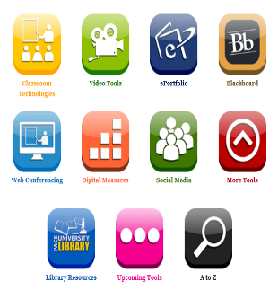
WHAT IS DIGITAL MEASURES?
Platform where faculty can update their teaching, scholarship, and service for the public to see.
Access through the ITS Digital Toolkit
Login with Pace credentials.
Digital Measures Demonstration
https://www.youtube.com/watch?v=0f3rHUGAyl8
http://www.pace.edu/digitaltoolkit
Notes:
What is Digital Measures?
I’m going to show you a nice, brief video that gives good overview of what it is and how it works.

Slide 11
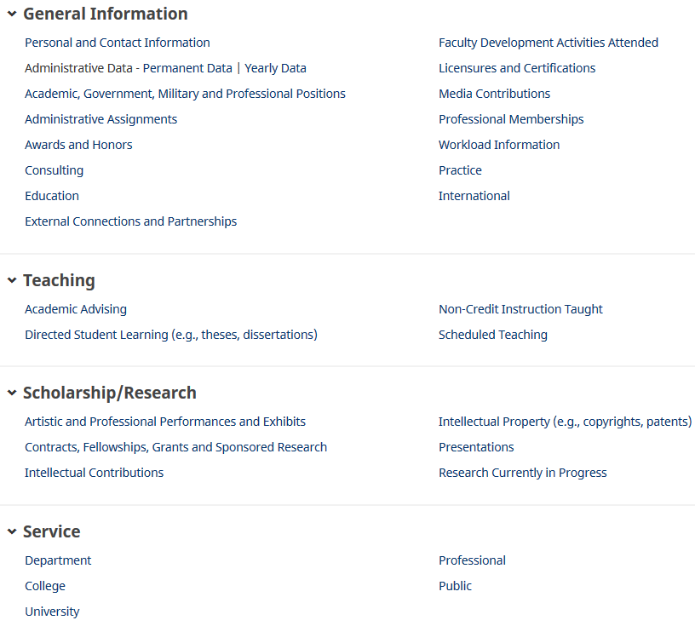
MANAGE ACTIVITIES SCREEN
Notes:
Use Beth’s profile for the example
This is the home-screen that have different sections where faculty can enter in their data.
These are the headings that faculty can use to populate their profiles (I’ll show you in bit what the profiles look like that the public can see)
General Information section
Teaching
Scheduled Teaching: Updated automatically
Advisement
Scholarship / Research
Contracts, Fellowships, Grants, and Sponsored Research
Intellectual Contributions (Publications)
Presentations
Service to the Dept., College, and University

Slide 12
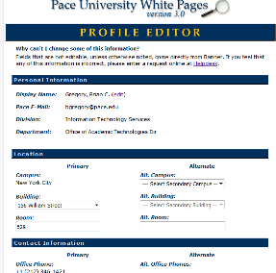
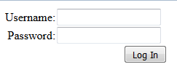
UPDATE PRE-LOADED
INFORMATION IN WHITE PAGES
https://whitepages.pace.edu
Notes:
Digital Measures comes preloaded with Banner information. To change or update this information:
Login to whitepages.pace.edu
Click on the Edit Your Info tab and click Display Name Editor and enter your username and password to edit your display name
Click on Profile Editor to edit secondary campus, primary/secondary building and room number, cell phone numbers, etc.
If other information is incorrect (division/department/job title) please enter a request at the Help Desk: https://help.pace.edu/.
After the White Pages has been updated, contact Academic Technologies so we can refresh this information.

Slide 13
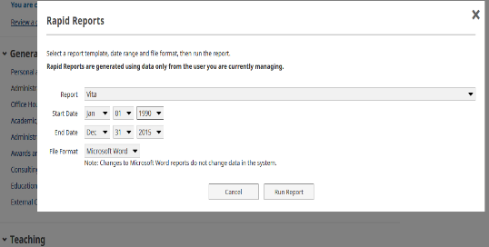
PRINTING A CV
CV Rapid Report
Dropdown menu > Vita.
Specify period of time for the CV
Notes:
Faculty can print their CV by running a report, called a Rapid Report, which they can print, save, or distribute to those who need it.
Select CV from the drop-down menu
Choose the range of dates for the items to create the CV for.

Slide 14
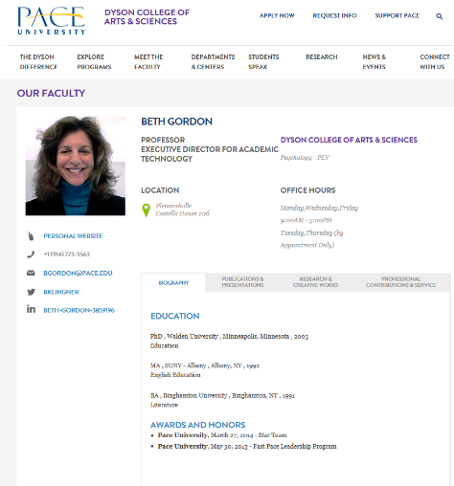
NEW PROFILES
Dyson faculty listing

Slide 15
http://www.pace.edu/digitaltoolkit

Slide 16
Academic Technologies: OER Update Heather Askildsen (haskildsen@pace.edu)

Slide 17
Heather Askildsen, Office of Academic Technologies
haskildsen@pace.edu
(914) 923-2507

Slide 18
How much do students spend on textbooks per year?
On average, students spend $1,100 on course materials annually¹ .
$1,100
Notes:
Open today’s webinar with a discussion about the costs of textbooks:
On average, students spend $11,000 on course materials annually.
Restricts access to education to:
Traditional low–income students
Non-traditional, continuing education students
If you are a single parent, you have dependents

Slide 19
What is OER?
Notes:
OER stands for Open Educational Resources. The key word being open, referring to that fact that OERs are academic materials in the public domain.
The OER movement is based on the principle that information should be shared and intellectual collaboration should be encouraged.
One form of OER are eTextbooks which educators can redistribute and remix to fit their unique classroom needs. OERs can be used to supplement or replace increasingly expensive traditional course materials.

Slide 20
Pace University Library Guide
libguides.pace.edu/openaccess
Notes:
Our university librarians have comprised a collection of open access (free) resources:. Free does not mean low quality. These were not free to create, but they are free to use.

Slide 21
Integrate OER into Blackboard
Notes:
Academic Technologies
Our door is always open if you want help integrating OER into your lesson plan
Because these are digital resources, they can easily be embedded into our school’s learning management system:
Web links
Learning Modules (Khan Academy)
Articles
Items
Full Textbook PDFs (OpenStax)
PowerPoint Slides
Embedded Media
Videos
Lectures
Interviews
Explainer
Audio
Podcasts
Music

Slide 22
Contact Us…
Heather Askildsen, Academic Technologist
(914) 923-2507
haskildsen@pace.edu
Christina Blenkle, Supervising Librarian
(914) 773-3222
cblenkle@pace.edu

Slide 23
References
¹ Spilovoy, T. (2016) Strategies and tools for finding, adopting, and managing OER. [PowerPointSlides].
Retrieved from attendee.gotowebinar.com/recording/viewRecording/290258247689336578…

Slide 24
Academic Technologies: Winter Builds Update George Chacko (gchacko@pace.edu)

Slide 25
Winter Upgrades
W510 and 511
David J Pecker Hall
Video conference

Slide 26
W510-511 – Active Learning Classrooms
Spacious mobile chairs (bumper car style)
Glass Whiteboards in front and WINK paint around the room
Power outlets around the room for students to plug in
6 displays around the room
Individual controls at each display
Displays can be lowered to enhance group work
Airmedia allows for wireless connectivity for iPhones and android devices

Slide 27
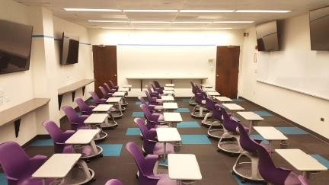
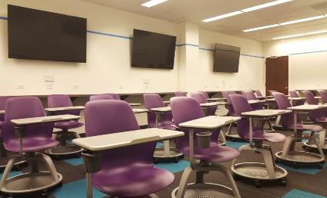

Slide 28
David J Pecker Hall – Features
Collaboration tables (Tiered)
Ability to reconfigure seating to accommodate a variety of teaching methods including lecture, project-based learning, and other options
Power to the desk
Video conferencing and capture enabled
AirMedia for Wireless connections for devices (Apple and Android)
LED Lighting with several programmed setting
Dual Projection (5k lu Lampless laser projectors)
Same source on both screens
Two different sources – one on each screens
2 additional confidence monitors in the back

Slide 29
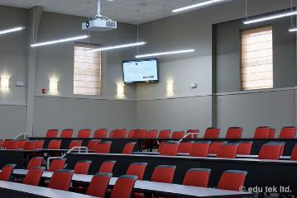
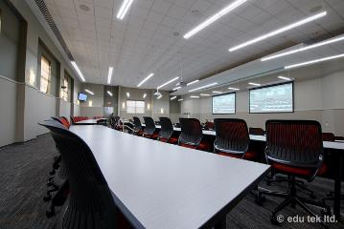
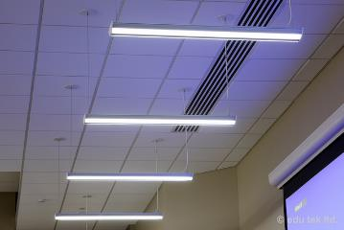

Slide 30
Miller 16 and E319
Fast, direct switching between active speakers provides an optimal, continuous meeting experience.
Multispeaker views prevent unnecessary switching when the next active speaker is already in the current shot.
Automatic framing of all participants provides a dynamic overview of the full room.
A discreet industrial design and wall mounting allows for a clean, sleek room setup.
Clear 1080p60 HD resolution offers the best possible image quality.

Slide 31
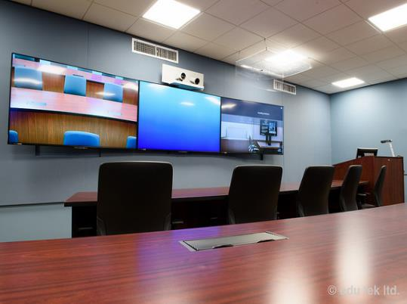
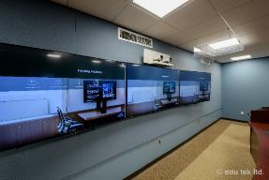
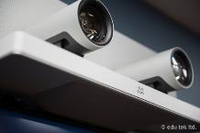
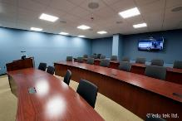
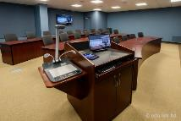

Slide 33
Contact us at: email: acadtech@pace.edu

Slide 34
IT Security: Identity Finder Training & Attestation Email Larry Robcke (lrobcke@pace.edu)

Slide 35
IT Security
Attestation email reminder – coming from Qualtrics survey
Identity Finder updates- Credit card info in emails must be removed by June 2016
Complete your Secure the human training - https://pace.securingthehuman.org

Slide 36
Network Services: New Wi-Fi Process Joe Blando (jblando@pace.edu)

Slide 37
Wireless Improvements
Summer 2016

Slide 38
PACE-WIRELESS
New Certificate Vendor
Improved “One Click” type connection
Connect →
Accept New Certificate→
Enter in Credentials

Slide 39
No More Registration
At this time users will no longer be required to register
The PACE-OPEN process will not be used, it will be replaces with a simpler “one click” type connection approach.

Slide 40
No More PACE-OPEN
PACE-OPEN will be replaced with PACE-GUEST. This will ONLY be used for GUEST Access.

Slide 41
PACE-HELP
SSID for ITS Help Desk and CSO Staff.
Only Broadcasted in or near CSO and the Help Desk Areas.

Slide 42
Web Services: Edublogs Services Gabe Terrizzi (gterrizzi@pace.edu)

Slide 43
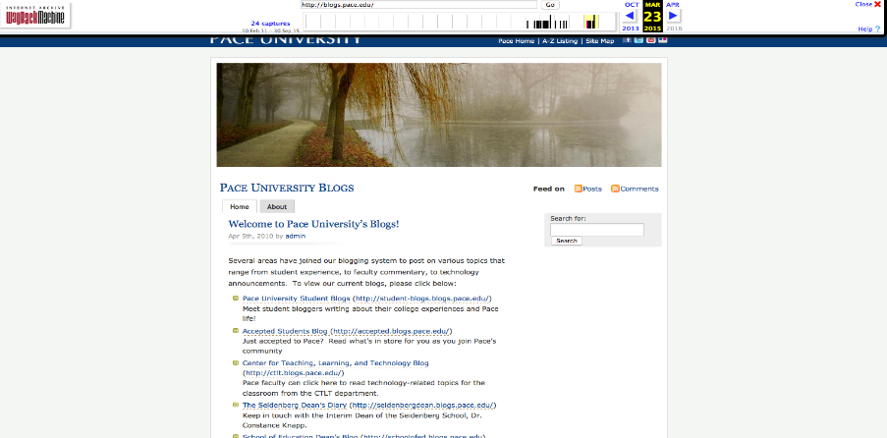
Old Pace Blogs Template
Hosted by Pace University
(Old) (Insecure) WordPress

Slide 44
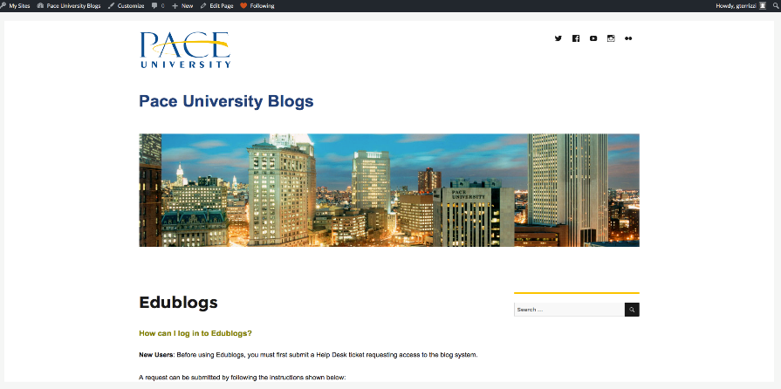
blogs.pace.edu
Customized Pace Blogs Template
Hosted by Edublogs
(new) (secure) WordPress

Slide 45
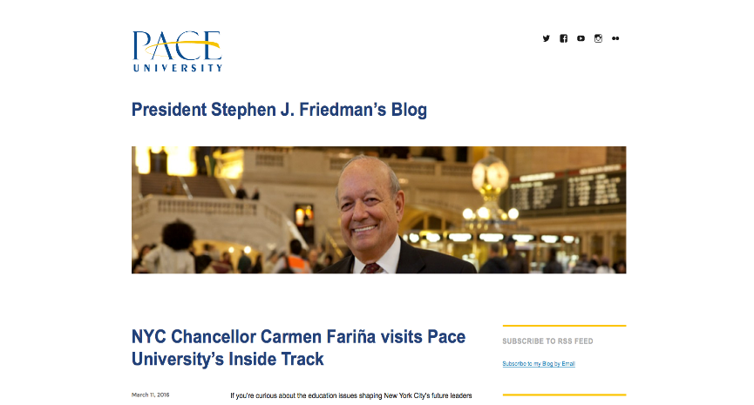
pacepresident.blogs.pace.edu
Customized Pace Blogs Template
Hosted by Edublogs
(new) (secure) WordPress

Slide 46
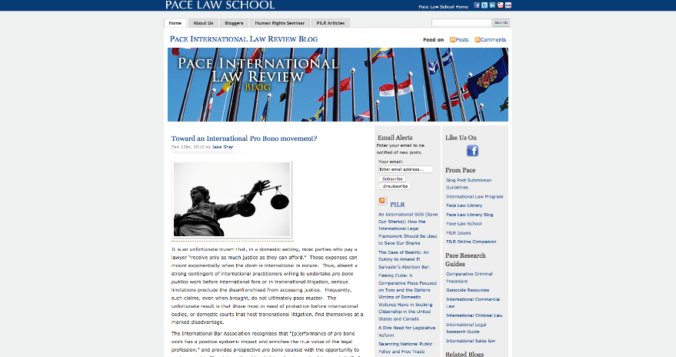
pilr.blogs.law.pace.edu
Old Pace Blogs Template Hosted by Pace University (Old) (Insecure) WordPress

Slide 47
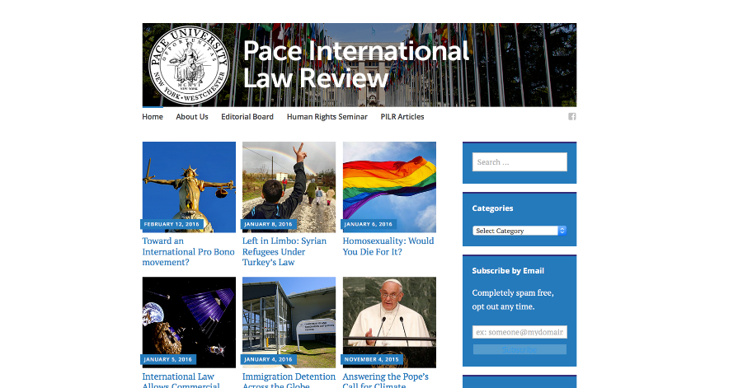
pilr.blogs.pace.edu
Customized Pace Blogs
Hosted by Edublogs
(new) (secure) WordPress

Slide 48
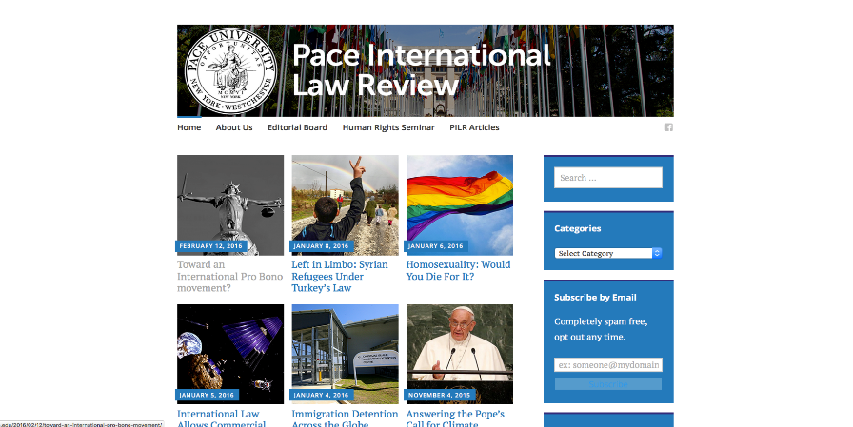
pilr.blogs.pace.edu
Customized Pace Blogs – hover state
Hosted by Edublogs
(new) (secure) WordPress

Slide 49
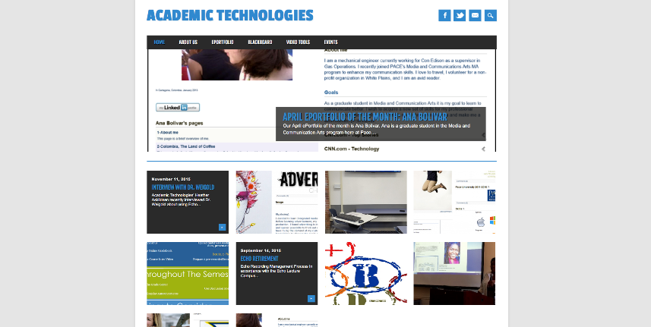
academictechnologies.blogs.pace.edu
Customized Pace Blog – Academic Tech
More than 250 approved themes
100’s of secure plugins

Slide 50
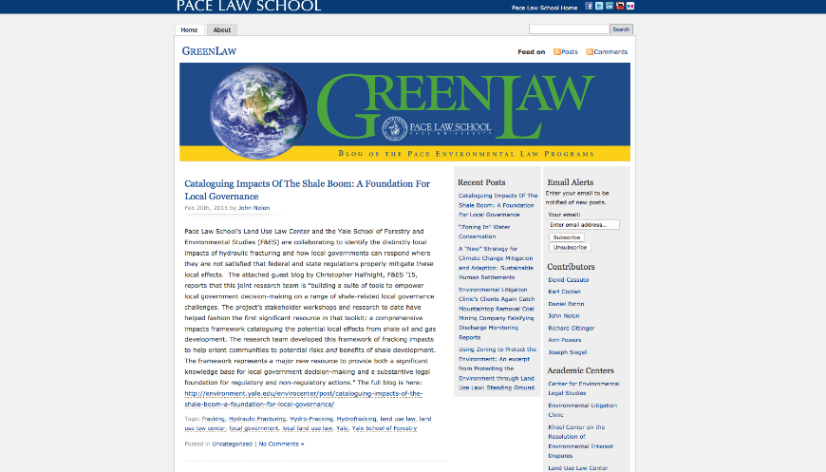
Greenlaw – old responsive view
greenlaw.blogs.law.pace.edu

Slide 51
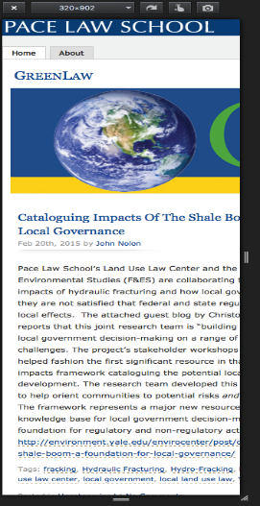
greenlaw.blogs.law.pace.edu
Greenlaw – old responsive view

Slide 52
greenlaw.blogs.pace.edu
Greenlaw – new responsive view

Slide 53
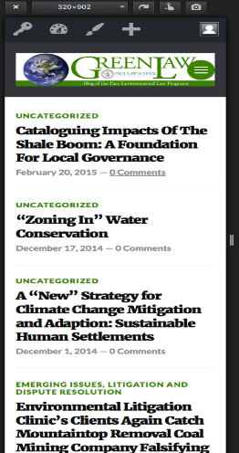
greenlaw.blogs.pace.edu
Greenlaw – new responsive view

Slide 54
Requesting a Blog
Log in to help.pace.edu using your MyPace username and password
Click on Request tab
Select the following Request Type: Information Technology > Blog Requests > Create Blogs
Provide the needed information in each field. Note: The information icon will provide further details of what is requested from the input field.
Click the Save button.
Must be for official Pace business: classes, research projects, student groups, etc. No personal blogs. For that we suggest Blogger.

Slide 55
Questions?
Suggestions?

