Slide 1
Conducting Effective Peer Observations
Spring 2020
Faculty Center Event
Joan Walker
Associate Professor, School of Education

Slide 2
Why Peer Observation?
Extrinsic
Intrinsic
Job requirement
Annual review process
Documentation of teaching effectiveness
Desire to improve one’s teaching
Desire to serve and mentor
Additional data point for interpreting student evaluations

Slide 3
Challenges and Questions about Peer Observation?
Observer
Observee

Slide 4
3 Phases of Effective Peer Observation
Before
Inviting / Suggesting an Observation
Purpose
Goals
Syllabus
Scheduling
During
Tools for Capturing What is Observed
Field notes
Diagrams
Rubrics
Checklists
After
Debriefing the Observation
Creating a Formal Observation Summary

Slide 5
BEFORE: Inviting / Suggesting an Observation
Purpose, Roles and Process
Why is the observation being conducted?
Is the observation confidential or part of someone’s teaching dossier or annual review?
What will happen during and after the observation?
Goals/Outcomes
What does each party want to achieve / learn from the experience?
“Is there anything specific you’d like me to pay attention to?”
Materials
Syllabus and course schedule
Course overview, learning objectives and key assessments
Scheduling
~One hour, mutually convenient
Typical class session

Slide 6
3 Phases of Effective Peer Observation
Before
Arranging an Observation
Purpose
Goals
Syllabus
Scheduling
During
Tools for Capturing What is Observed
Field notes
Diagrams
Rubrics
Checklists
After
Debriefing the Observation
Creating a Formal Observation Summary

Slide 7
A Sample of Tools for Capturing the Observation
Field notes: Keep a time-stamped running, written record; embed questions and suggestions
Diagrams: Capture discourse in 2-D formats
Rubrics/Checklists: Easy to use; add narrative that complements categories/criteria

Slide 8
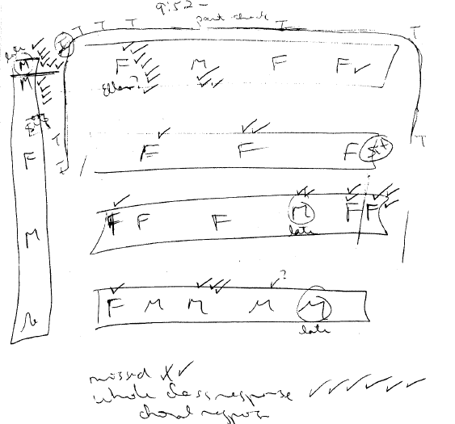
Field Diagram
Captures discourse and physical set up
T = Teacher
F/M = Student gender
= Speaking
Other symbols can track quality of verbal exchanges, e.g.,
P = Praise statements
? = Question
F? = Factual question
C? = Conceptual question

Slide 9
Context or Background Information:
Describe the setting in which the lesson took place, relevant information about the makeup of the class, and any other descriptive characteristics that would provide appropriate context to the observation.
Area 1: Instructor Goals/Intentions
clearly stated or portrayed in an obvious fashion
appropriate to the focus of the course
explicitly connected to the flow of previous or future classes.
Area 2: Significance of activities, topics
Tasks/activities performed by students or topics discussed:
Were relevant to the focus of the course
required an appropriate investment of student time or effort
Area 3: Student engagement
with the subject matter was observable:
in appropriate forms such as discussion, listening/processing, performing, reading, reflecting, speaking, or writing.
over a substantial portion of the class time
by a broad segment of students
Area 4: Examination of student learning
questioning students on course material,
observing student performance(s),
student-student discussion,
informal assessment techniques,
quizzes, or
other methods.
Overall Rating of Observed Teaching: _________
1=Highly satisfactory 2=Satisfactory 3=Could use improvement 4=Unsatisfactory

Slide 10
3 Phases of Effective Peer Observation
Before
Arranging an Observation
Purpose
Goals
Syllabus
Scheduling
During
Tools for Capturing What is Observed
Field notes
Diagrams
Rubrics
Checklists
After
Debriefing the Observation
Creating a Formal Observation Summary

Slide 11
AFTER: Debriefing the Observation
Observer
Observee
Remember: It’s only a snapshot.
Share field notes in advance.
Use the debrief to confirm accuracy of notes & gather more information.
Emphasize the purpose and goals. Focus on learning.
Be kind. Start with an open-ended prompt, e.g., “How did the class go for you?”
Identify areas for growth
Immediate
Longer-term
Remember: It’s only a snapshot.
Provide a larger context for your peer.
Learning to teach takes time.
Avoid defensiveness.
Don’t be hard on yourself.
Selectively set specific, achievable goals for improvement.
Implement 1 or 2 goals in your teaching assignment.

Slide 12
Writing it Up: A 3-Part Summary / Memo
Set the Context: Describe how the observation was arranged and its purpose.
E.g., Dr. X asked if I could visit her class to provide a peer observation letter that she could include in her application for tenure. She added that she would like me to look for….
The class that I observed was [course title/#], which meets [schedule, e.g., once a week for 3 hours; twice a week for 90 minutes].
As per the syllabus, [include the course description and learning objectives here; this language then guides the observer as to what should be found in course materials and classroom interactions].
The syllabus also detailed specific learning outcomes. E.g., Students will be able to:
[bullet point outcomes here]
Add any other comments about artifacts you examined such as an email from the instructor to the students about how to prepare for the observed session.

Slide 13
Writing it Up: Summarizing Field Notes
Field Notes [describe when and how long you observed; at what point in the semester the observation occurred]
I observed on X date for X time, which was the X session in the semester. [e.g., the final 75-minutes of the weekly 3-hour class during the second week of the semester].
Instructor-focused remarks: Sequence of activities, Checking for understanding
When I entered the classroom, Dr. X was…..
Before the whole class work, she asked students to ….
After this activity, Dr. X ….
Student-focused remarks: Engagement observed by how many, in what & for how long.
The students began to work right away ….
Some small subgroups formed and some students were working alone. All were engaged.
As they worked, I heard snippets of conversation indicating that students were using Dr. X’s remarks…

Slide 14
Writing it Up: Closing the Summary
Summarize the Post-Observation Conversation:
After the observation, Dr. X and I discussed the class. I focused first on notable strengths in her teaching.
The first notable feature of this class was…
Another notable feature was …..
We then discussed …. (e.g., how her teaching relates to her scholarship)
We then explored possibilities.
For example, I asked her whether she had considered…..
Dr. X noted that one goal for her teaching was…..
In summary, my observation and analysis of the course materials demonstrated that Dr. X’s teaching is…….

Slide 15
Additional Online Resources
Centers for Teaching at other institutions:
https://cft.vanderbilt.edu/guides-sub-pages/peer-review-of-teaching/
http://www.crlt.umich.edu/resources/peer-review
http://crlt.umich.edu/sites/default/files/resource_files/Chapter_7.pdf
Thank you!
Direct inquiries to Joan Walker, jwalker@pace.edu

Slide 16
The Pre-Observation Phase
Scenario A:
A junior faculty member approaches you to ask for a peer observation.
Scenario B:
You need to approach a colleague and suggest that a peer observation.
What do you say and do?
What do you NOT say and do?

Slide 17
The Post-Observation Phase: 3 Potential Outcomes
Scenario #2
You have observed a colleague.
His / her teaching was……
Very effective
Ineffective
Somewhere in between
What do you say and do?
What do you NOT say and do?

