Slide 1
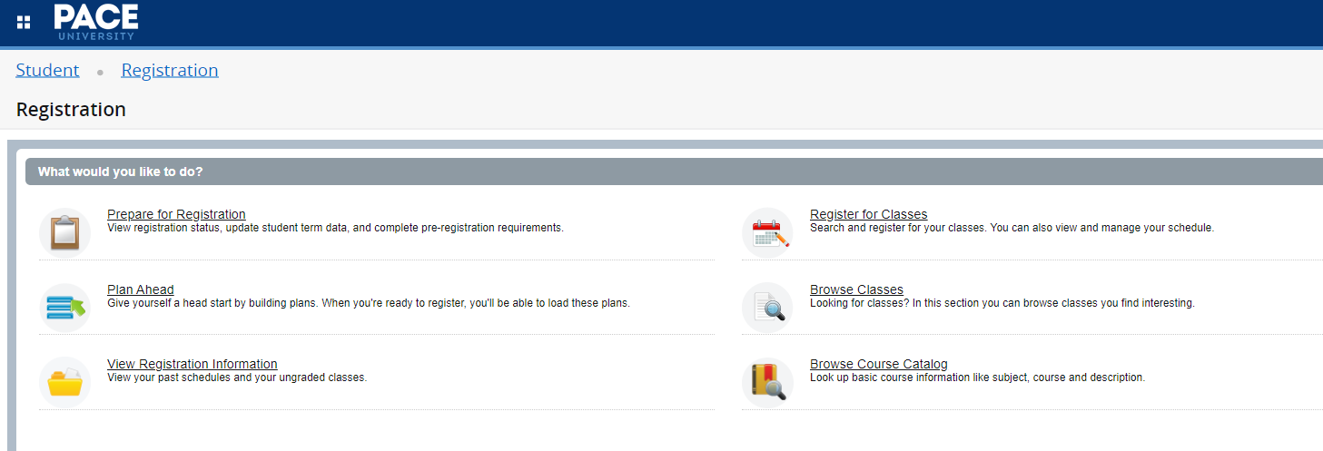

Slide 2
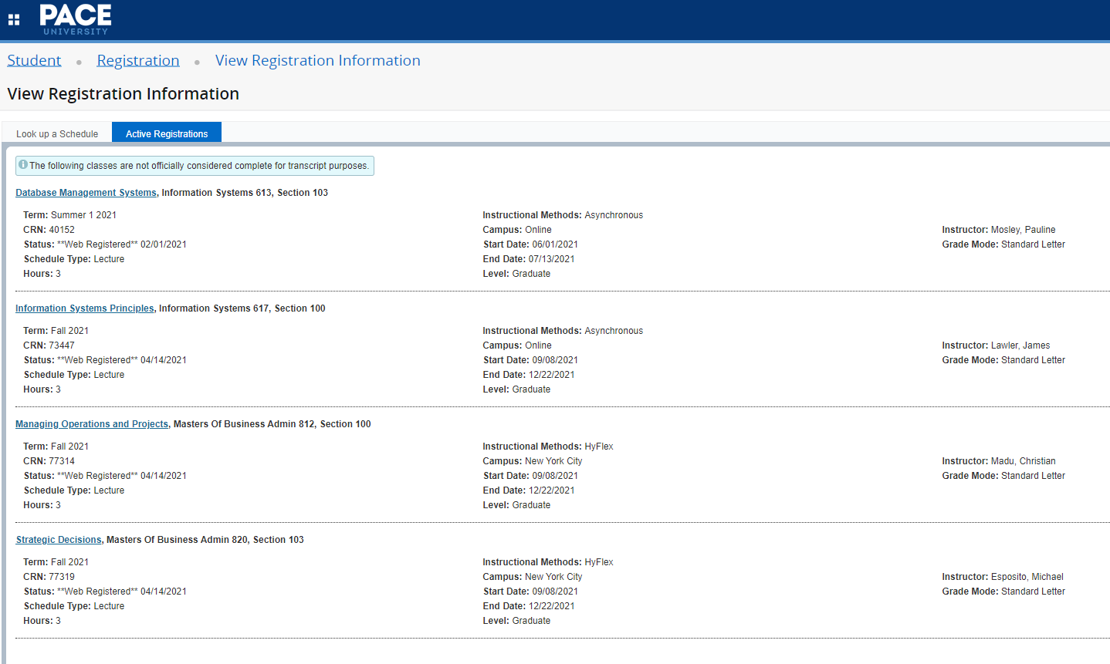
This is how your schedule will appear.

Slide 3
