Slide 1
New Program Submissions
Instructions and Workflow including Important FY25 Submission Dates
Updated 9/1/22 – Rev 11/16/22 – Rev 3/17/23

Slide 2
Instructions
Internal Review Grid (IRG)
  To be used for the review and approval for ALL ACADEMIC PROGRAM SUBMISSIONS
  The Internal Review Grid provides a comprehensive summary of the review and approval steps needed for:
    All undergraduate and graduate programs, courses, and non-credit bearing programs
    Indicates which new programs and program revisions are required to be submitted to NYS for approval
2. Business Case Proposal and Financial Proforma
  To be completed for ONLY THOSE ACADEMIC PROGRAMS REQUIRING new financial resources
  (eg, faculty, adjuncts, capital, space, supplies & services, etc.)
  These forms provide a comprehensive summary of the market demand and financial resources needed for the new program submission:
    Business Case Proposal provides a comprehensive market study and program assessment
    Financial Proforma provides a 5-year financial projection of enrollment, revenue, and profit
      See Deans Council presentation dates (slide 9 )

Slide 3
Workflow Summary
Revise Program Submission
New Undergraduate or Graduate Program Submission
Course Forms or Non-Credit Bearing Programs
Does this program require new financial resources (eg, faculty, adjuncts, capital, space)?
Does this program require new financial resources (faculty, adjuncts, capital, space)?
Does the course have a proposed area of knowledge (AOK) designation?
If not, complete the necessary steps as outlined in the Internal Review Grid (IRG) on slides, 5-7.
If yes, complete the necessary steps as outlined in the Internal Review Grid (IRG) on slides, 5-7.
Prepare the Business Case Proposal and Financial Proforma as described on slide 8.
Note important FY25
(Fall 2024/ Spring 2025) submission deadlines and presentation dates to
Deans Council as described on slides 9.
If not, complete the necessary steps as outlined in the Internal Review Grid (IRG) on slides, 5-6.
If yes, complete the necessary steps as outlined in the Internal Review Grid (IRG) on slides, 5-6.
Prepare the Business Case Proposal and Financial Proforma as described on slide 8.
Note important FY25
(Fall 2024/ Spring 2025) submission deadlines and presentation dates to
Deans Council as described on slide 9.
If not, complete the necessary steps as outlined in the Internal Review Grid (IRG) on slide 7.
If yes, complete the necessary steps for AOK designation as outlined in the Internal Review Grid (IRG) on slide 7.
Follow the necessary steps for a new or course change procedure.

Slide 4
1. Internal Review Grid (IRG)
The Internal Review Grid provides a comprehensive summary of the review and approval steps needed for all undergraduate and graduate programs, courses, and non-credit bearing programs
The Internal Review Grid indicates which new programs and program changes need to go to New York State for approval
Please note that the IRG was approved by BOTH the NYCFC and Westchester FC on 2/5/20 & 2/7/20, respectively.
Please note that Footnote #6 was added on 6/26/20 to conform to new Middle States Accreditation Requirements.

Slide 5
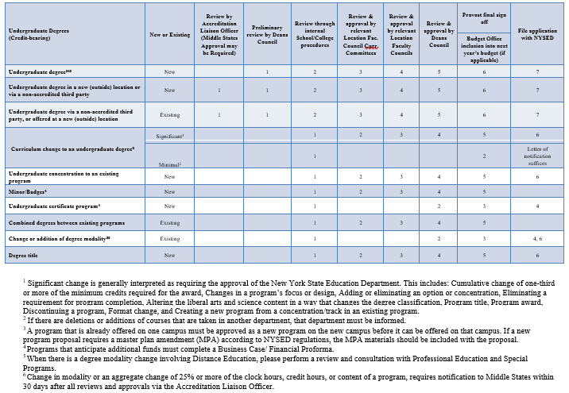
IRG – UG Degrees

Slide 6
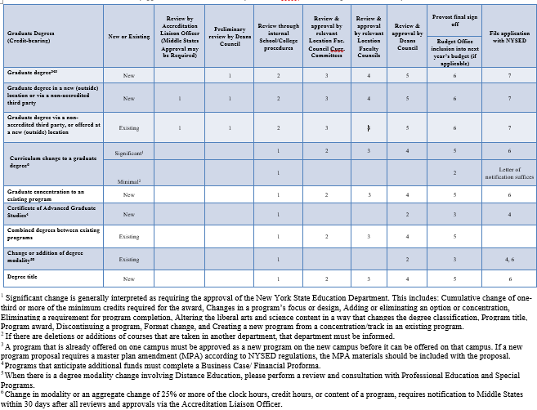
IRG – GRAD Degrees

Slide 7
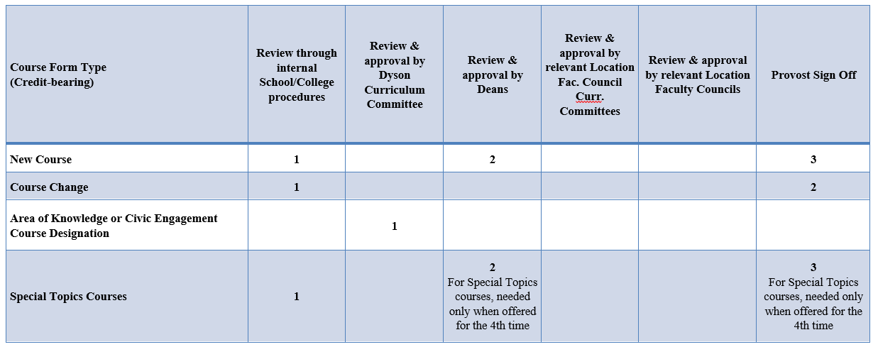
IRG – Other

Slide 8
2. Business Case Proposal & Financial Proforma
The following documents should be completed for all academic program submissions requiring new financial resources (eg, faculty, adjuncts, capital, space):
  Business Case Program Proposal - a conclusive narrative of the program, including a comprehensive market study and program assessment
  Financial Proforma Model - A 5-year financial projection of enrollment, revenue and profit (see separate files for undergraduate and graduate/special programs)
These documents will be presented at Deans Council (presentation dates on slide 9)
Please note that the Business Case Proposal and Financial Proforma templates can be found on the Pace website at www.pace.edu/PROVOST (and select Polices and Forms)

Slide 9
Important Fall 2022 & Spring 2023 Dates – REVISED DATES
Please Note: This timeline ONLY applies to program submissions with new financial resource requests.
All new programs requiring new financial resources must be fully approved by June 2023
for inclusion in the FY25 Budget (Fall 2024/Spring 2025).
Preliminary Review by Deans Council
Financial Aid Review Committee (FARC)
Final Review & Approval by Deans Council
Review of FY25 Business Case Program Proposals
Review of programs with special tuition pricing, scholarships, or financial aid
Review of the FY25 Financial Proformas
for approved Business Case Program Proposals requesting new financial resources
Meets every Tuesday from 1:30pm - 2:30pm
September 27, 2022
October 25, 2022
March 21, 2023* (date changed from 3/14/23)
February 14, 2023
June 13, 2023* (date changed from 5/9/23)
April 11, 2023
November 22, 2022

Slide 10
Approval Workflow
For new programs and/or programs that require additional financial resources:
Deans Council
Business Case Proposals Preliminary Approval
*Can be performed in conjunction with MSCHE (if req’d)
Approval by various Faculty Councils (IRG)
Provost & Budget Office
Final Approval
Needed for
FY25 Financial Proformas for Budget Inclusion
FARC / Tuition & Pricing
If applicable, to vet special tuition pricing, scholarships, and financial aid
Submit to NYSED*
*Note: Dependent on program, might run concurrently with other internal and administrative processes
Deans Council
Business Case Proposals & Financial Proformas
Final Approval

Slide 11
FY25 Timeline
For programs that require new financial resources, the goal of this timeline is to align the financial, operational, and human resource needs with the annual budget cycle.
May/June 2023
Proformas approved for the Fall 2024/Spring 2025 (FY25)
June 2023
Request for capital funds for FY25
July 2023
Review and approval of new faculty requests for Fall 2024 hire (FY25)
November 2023
Submission of new financial resources as part of FY25 annual budget cycle
January 2024
All new program proformas (enrollment, revenue, and expenses) included as part of the FY25 budget
June 2023
Annual Reports due with review of prior year, objectives for current year, and resources needed for new year (FY25)
Sept 2022- Mar 2023
Business Case Program Presentations to Deans Council

Slide 12
Next Steps
Significant lead time is often needed to prep for program launches. Examples include:
    Prepping all marketing and recruiting materials
    Creating the application in Slate
    Creating the program web site and links
    Creating program codes
    Scheduling courses and assigning staff
    Course development
    Approving tuition pricing and aid packages
    Creating orientations and onboarding for new students
    Adding content to the university catalog
Consultation and notification with non-academic departments (such as admissions, marketing, financial aid, enrollment management, tech support) can be initiated while waiting for NYS approval.

Slide 13
Questions ?
For questions on the NYSED approval process or Business Case Proposal and Financial Proforma, email programreview@pace.edu
For questions on MSCHE, email ALO@pace.edu
Please visit the Pace University website:
  www.pace.edu/PROVOST (Polices and Forms)

