Slide 1
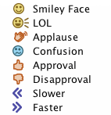
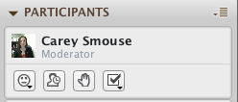
Tips for using Blackboard Collaborate…
Using the PC for Audio
Configure Your Mic and Speakers
Go to: Tools > Audio > Audio Setup Wizard
Using the Telephone
Click the handset icon in the Audio & Video Panel, highlighted below
Interactive Tools

