Slide 1
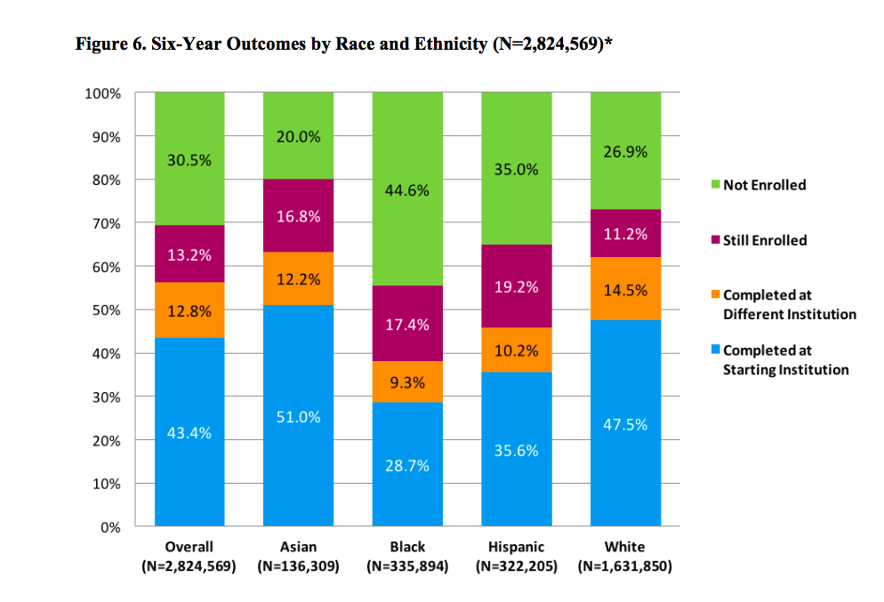
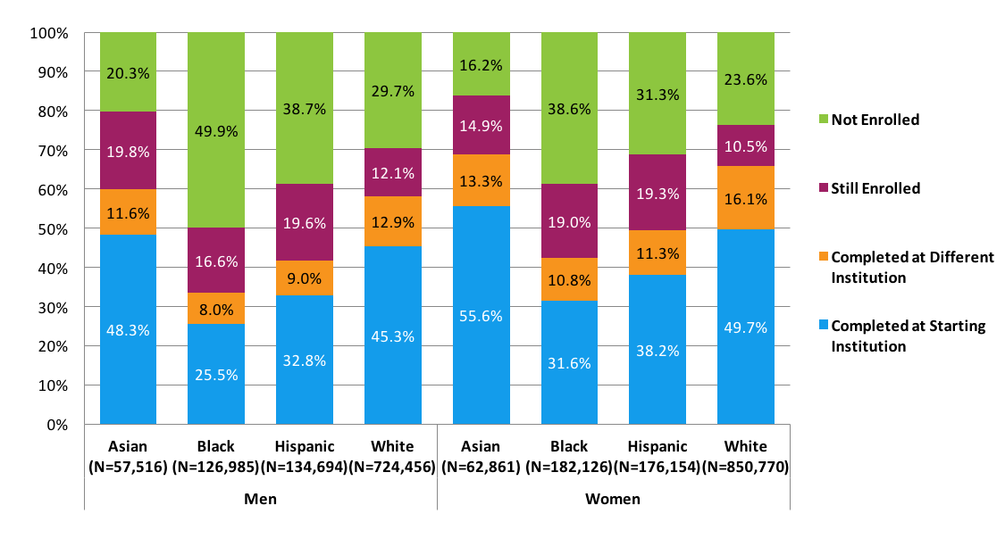
Ethnicity and Race Perspective
National Student Clearinghouse
https://nscresearchcenter.org/signaturereport12-supplement-2/
Figure 7. Six-Year Outcomes by Race and Ethnicity and Gender (N=2,315,562)*
White and Asian students completed their programs at similar rates -- 62 percent and 63.2 percent, respectively
while Hispanic and black students graduated at rates of 45.8 percent and 38 percent, respectively.
Black and Hispanic students were no more likely to transfer and graduate somewhere else
Black and Hispanic students in fact, in most cases, they were less likely to graduate

Slide 2
Ethnicity and Race Perspective

Slide 3
Examples of how to address ethnicity and race perspectives
Independent college frame
Community college frame
Acceptance letter:
“…I m delighted that you and your family decided that you should attend Stanford University..”
Acceptance letter:
Together with the Stanford community, you will have many opportunities to explore new areas and to learn from yur experiences and interactions with your peers”

Slide 4
Even With Affirmative Action, Blacks and Hispanics Are More Underrepresented at Top Colleges Than 35 Years Ago
By JEREMY ASHKENAS, HAEYOUN PARK and ADAM PEARCE AUG. 24, 2017
+8
+4
-4
-8
Over represented
Under represented
Whites Asians Hispanics Blacks
How much more or less each group is represented among freshmen at top colleges relative to the U.S. population

