Slide 1
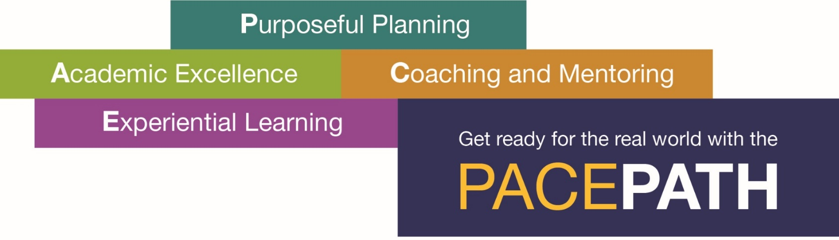
Pace Path to Success: Combining Academic and Real-World Experiences through Purposeful Planning and Mentoring.

Slide 2

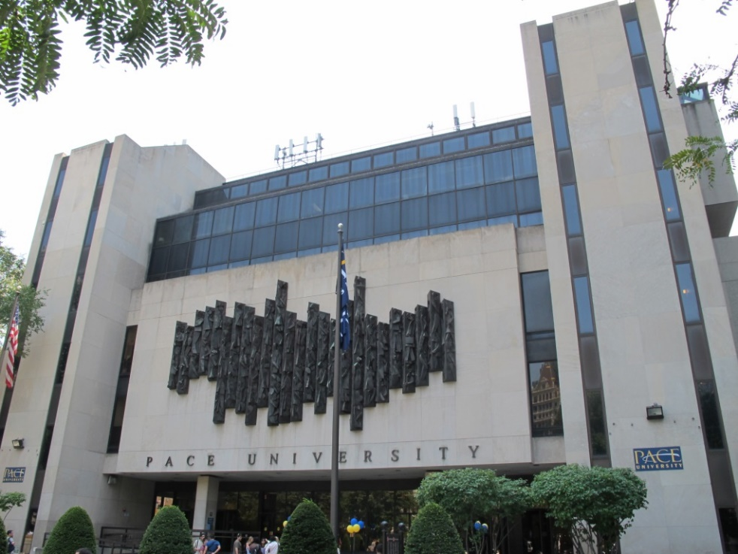

Pace Path

Slide 3
Pace Path
Pace University provides to its undergraduates a powerful combination of knowledge in the professions, real-world experience, and a rigorous liberal arts curriculum, giving them the skills and habits of mind to realize their full potential.
The Pace Path helps facilitate
these goals within Pace’s
historic mission of
Opportunitas.

Slide 4
Pace Path
Pace has been acknowledged for exceptional outcomes for its students by outside sources.
  Recently Pace was ranked second place nationally by the Equality of Opportunity Project for upward mobility based on students moving from the bottom fifth to top fifth in income distribution.
  PayScale ranked Pace in the top 9% for future salary potential.
  Business Insider ranked Pace as the number one underrated university in the US, which means Pace has tremendous potential to grow its national reputation.

Slide 5
What is Pace Path?
The Pace Path combines academic and real-world experiences through purposeful planning and mentoring.
The Path guides all undergraduate students toward becoming successful, sought-after leaders in their fields.
It had a limited introduction in fall 2014 with more robust implementation in fall 2015 starting with University 101, the introductory first-year orientation class.
There are four pillars supporting the Pace Path.

Slide 6
Pillar 1
P
Purposeful Planning

Slide 7
Pillar 1
Pace Path Plan: Your Four Year Guide to Success in University 101 found here.
Students prepare measureable goals and actions steps for their four years at Pace University, which change with the students over time.
Continued check-in with advisors occurs over four
years.

Slide 8
Pillar 2
A
Academic Excellence

Slide 9
Pillar 2
Pace University offers strong undergraduate academic programs across five Schools and Colleges.
All programs have a common foundational core in order to develop important literacies in the 21st Century such as quantitative, reading and writing, and technological skills.
Each School and College has
an articulated Pace Path
website.

Slide 10
Pillar 3
C
Coaching and Mentoring

Slide 11
Pillar 3
Alumni-Student Mentoring Program
This program and multiple other mentoring opportunities are found on the Pace Path mentoring website.
Both faculty and peer mentoring
occur within University 101, and
mentoring continues within
professional programs.

Slide 12
Pillar 4
E
Experiential Learning

Slide 13
Pillar 4
Research: Undergraduate Student-Faculty Research Program and Undergraduate Student Academic Conference Travel Fund- provides funds for research and conference travel
Internships: Career Services
Service learning: Center for Community Action and Research and civic engagement core requirement
Exploring global culture with education
abroad: Pace International
Student organizations: Student Development
and Campus Activities
Click here for the experiential learning webpage.

Slide 14
What are the Learning Goals?
  Managing Oneself: The ability to conduct academic and professional relationships while maintaining focus on one’s own educational goals and personal development.
  Interpersonal Relations: The ability to relate to others both within and outside one’s own community in order to effectively collaborate with others.
  Organizational Awareness: The ability to understand and excel within the culture in order to achieve both personal and group goals.
  More information on the Learning Goals is found here.

Slide 15
Pace Path Early Start
Math Jump-Start: Fundamental math and algebra are available to students from selected quantitative-related majors based on placement exam scores on both campuses.
  Students who meet all of the academic requirements of the summer courses will have the opportunity to place into a higher math and/or science class during the academic year.

Slide 16
Pace Path Early Start
College Immersion: This program, held on the New York City campus in the last week of August, is designed to help students adjust to college life and thrive at Pace and in New York City.
Financial Counseling: Students and their parents/guardians will meet with Financial Literacy Counselors starting in the summer and several times throughout the first year.

Slide 17
Pace Path Early Start
Early Start success
  Math Jump-Start: Developmental math to help students get ahead and graduate in four years
    Current pass rate for program completers is 86%
    Course satisfaction in the 4 out of 5 Likert scale range
    Further data analysis is currently underway

Slide 18
Pace Path Early Start
  College Immersion: Introduction to college for possible at-risk students
    39 students in summer 2016 pilot in NY
    70 students (50 in NY and 20 in PLV) in summer 2017
    Satisfaction for 2016 in the 4 out of 5 Likert scale range
  Financial Counseling: In 2016, 502 incoming first-year students were invited with 41 taking advantage of the opportunity
    Eligibility was based on Pell grant, unmet need, and expected family contribution

Slide 19
Pace Path Early Start
  Retention
  We are currently tracking first-year retention rates for all three programs.
  Initial post census results indicate
    Math Jump-Start: Retained 99% of successful students
    College Immersion: 100%
    Financial Counseling: 100%

Slide 20
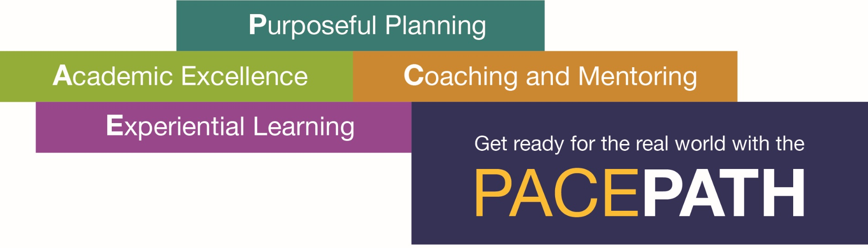
For more information…
  www.pace.edu/path
  Click for Pace Path website, videos, and brochure.

